Slide 1




ENTERPRISE NETWORK SECURITY BRIEFING
IPsec VPN
Secure Communication Over Untrusted Networks
From Protocol Theory to Live Cisco Implementation
ENCRYPTED TUNNEL
Cyber Security · Networking · Cisco IOS
Team 3 · Mohammed Hany Mamdouh · Ahmed Ehab Mohamed · Ahmed Samir Ibrahim

Slide 2

AGENDA
What We'll Cover
PART ONE
PART TWO
Foundations & Protocol Theory
Live Implementation — Cisco Lab
1
What is a VPN & why IPsec
1
Topology & network setup (R1 · R2 · R3)
2
IPsec core protocols — AH, ESP, IKE, SA
2
Phase 1 — IKE / ISAKMP configuration
3
Transport vs Tunnel mode
3
Phase 2 — IPsec data tunnel configuration
4
IKE phases & versions
4
Full running configuration walkthrough
5
How a secure tunnel is established
5
Verification & active Security Associations
6
Site-to-Site vs Remote Access VPN
6
Key insights from the lab
7
Algorithms, NAT traversal & best practice
7
Conclusion & takeaways
8
Advantages & limitations
IPSEC VPN | SECURE COMMUNICATIONS
02 / 24

Slide 3





FOUNDATIONS
What Is a VPN?
A Virtual Private Network (VPN) extends a private network across a public, untrusted network — typically the Internet — creating a logical, encrypted tunnel between two points.
ENCRYPTED TUNNEL
Confidentiality
User
Internet
Private Network
Keep sensitive data private while it crosses a public network.
Remote Access
Internal resources reachable as if directly connected
Let employees reach internal resources securely from anywhere.
Site Interconnection
Join branch offices or data centers as one logical network.
IPSEC VPN | SECURE COMMUNICATIONS
03 / 24

Slide 4



FOUNDATIONS
What Is IPsec?
IPsec (IP Security) is a framework of open standards, developed by the IETF, that provides security for IP traffic. It operates at the network layer (Layer 3), protecting and authenticating IP packets between peers — without requiring changes to applications above it.
Confidentiality
Data Integrity
Origin Authentication
Anti-Replay
Encryption hides data from unauthorized viewers.
Detects if data was altered in transit.
Confirms the identity of the sending peer.
Rejects old or duplicated captured packets.
Defined across RFC 4301 (Security Architecture) and companion RFCs consolidated in RFC 6071.
IPSEC VPN | SECURE COMMUNICATIONS
04 / 24

Slide 5



ARCHITECTURE
IPsec Core Building Blocks
AH
ESP
Authentication Header
Encapsulating Security Payload
Provides data integrity and origin authentication for the IP packet. No encryption. Defined in RFC 4302; optional in the current IPsec architecture.
Provides confidentiality (encryption) plus optional integrity and authentication. Defined in RFC 4303; used in virtually all deployments.
IKE
SA
Internet Key Exchange
Security Association
Automates peer authentication and negotiates the keys and algorithms (SAs) that AH/ESP will use, so keys don't need manual configuration.
A unidirectional agreement between two peers on the protocol, algorithms, and keys used to protect a specific data flow.
IPSEC VPN | SECURE COMMUNICATIONS
05 / 24

Slide 6
ARCHITECTURE
AH vs ESP
AH
ESP
Confidentiality (encryption)
No
Yes
Data integrity
Yes
Yes
Origin authentication
Yes
Yes
Anti-replay protection
Yes (optional)
Yes (optional)
Encapsulates the payload
No
Yes
Defining RFC
Defining RFC
RFC 4302
RFC 4302
RFC 4303
RFC 4303
Status today
Optional
Mandatory (MUST)
IPSEC VPN | SECURE COMMUNICATIONS
06 / 24

Slide 7
ARCHITECTURE
Transport Mode vs Tunnel Mode
TRANSPORT MODE
TUNNEL MODE
Only the payload of the IP packet is protected. The original IP header stays in place. Typically used for direct, end-to-end host-to-host communication.
The entire original IP packet is encrypted and encapsulated inside a new IP packet with a new header. Standard mode for gateway-to-gateway (site-to-site) VPNs.
IP Header
Encrypted Payload (ESP)
New IP Header
Encrypted Original Packet (IP Header + Payload)
Used for: host-to-host IPsec sessions
Used for: site-to-site & remote-access VPNs
IPSEC VPN | SECURE COMMUNICATIONS
07 / 24

Slide 8



KEY MANAGEMENT
IKE: Phases & Versions
IKEv1 — RFC 2409
IKEv2 — RFC 7296
Phase 1
Combines ISAKMP, key exchange and negotiation into one streamlined protocol (originally RFC 4306, consolidated into RFC 7296). Not interoperable with IKEv1.
Authenticates the peers and builds a secure ISAKMP SA (Main Mode — protects identities, or faster Aggressive Mode).
Fewer round trips — faster setup
Phase 2
Built-in NAT traversal & Dead Peer Detection
Quick Mode uses the Phase 1 channel to negotiate the actual IPsec (AH/ESP) SAs and keying material.
Native support for EAP / remote-access auth
Mobility support via MOBIKE
IPSEC VPN | SECURE COMMUNICATIONS
08 / 24

Slide 9




PROCESS
How a Secure Tunnel Is Established
1
2
3
4
5
Interesting Traffic
IKE Phase 1
IKE Phase 2
Secure Tunnel
SA Teardown
Traffic matches a configured crypto policy (ACL) and triggers IPsec.
Peers authenticate each other and build a secure control channel.
Peers negotiate the IPsec SA — algorithms and keying material.
AH/ESP now protect data using the agreed keys and algorithms.
SAs expire or are cleared; new keys are negotiated as needed.
IPSEC VPN | SECURE COMMUNICATIONS
09 / 24

Slide 10



DEPLOYMENT
Site-to-Site vs Remote Access
SITE-TO-SITE VPN
REMOTE ACCESS VPN
Connects two networks permanently through their firewalls/routers (gateways). Always uses tunnel mode. Ideal for linking branch offices or data centers.
Connects an individual client with a dynamic IP to a corporate gateway. IKE mode configuration assigns the client an internal address as part of negotiation.
Office A
Gateway
Office B
Remote User
Gateway
Static peers · Always-on · Transparent to users
Dynamic peers · On-demand · Per-user authentication
IPSEC VPN | SECURE COMMUNICATIONS
10 / 24

Slide 11


CRYPTOGRAPHY
Algorithms & Current Best Practice
Encryption
Integrity
Key Exchange (DH)
AES-CBC / AES-GCM
HMAC-SHA-256 / 384 / 512
Group 14+ (2048-bit) / ECDH
128-bit minimum, 256-bit for high assurance
Recommended replacement for SHA-1
Recommended minimum since 2013
3DES, DES
HMAC-MD5
Groups 1, 2, 5 (≤ 1536-bit)
No longer recommended
Avoid for new deployments
Too weak
Guidance reflects Cisco IOS XE hardening (17.11.1a+) and IETF cryptographic algorithm requirement RFCs.
IPSEC VPN | SECURE COMMUNICATIONS
11 / 24

Slide 12
PRACTICAL CONSIDERATIONS
NAT Traversal & Firewall Rules
The Problem
The Fix: NAT-T
Network Address Translation (NAT) rewrites IP/port information in packet headers. This breaks AH's integrity check and complicates ESP, since NAT devices historically expect TCP/UDP ports that ESP alone does not provide.
NAT-Traversal (RFC 3947 for IKE negotiation, RFC 3948 for encapsulation) detects NAT devices between peers and wraps ESP packets inside UDP so they can pass through the NAT unmodified.
REQUIRED FIREWALL RULES
Allow UDP port 500 (IKE)
Allow UDP port 4500 when NAT-T is used
Allow ESP — IP protocol 50
Allow AH — IP protocol 51
Recommendation: use static NAT and apply it before IPsec encapsulation whenever possible.
IPSEC VPN | SECURE COMMUNICATIONS
12 / 24

Slide 13
EVALUATION
Advantages & Limitations
Advantages
Limitations
Strong, standards-based security services
Configuration complexity, especially at scale
Transparent to applications — no app changes needed
NAT compatibility requires extra handling
Widely supported across vendors & platforms
Encryption/decryption adds processing overhead
Protects any IP traffic, not just a single app
Designed for unicast; multicast needs extensions
IPSEC VPN | SECURE COMMUNICATIONS
13 / 24

Slide 14
PART TWO
From Theory to Practice
Live Site-to-Site IPsec VPN Implementation on Cisco IOS
Topology
IKE Phase 1
IPsec Phase 2
Verification
IPSEC VPN | SECURE COMMUNICATIONS
14 / 24

Slide 15




LIVE IMPLEMENTATION
Lab Topology & Network Setup
IPsec TUNNEL
PC-A
PC-C
R1 — Branch A
R2 — WAN / ISP
R3 — Branch B
192.168.1.0/24
Pass-through only
192.168.3.0/24
R1 (Branch A)
R2 (WAN ISP)
R3 (Branch B)
Routing Base
Local LAN 192.168.1.0/24 hosting PC-A.
Intermediary router connecting R1 and R3 without VPN awareness.
Local LAN 192.168.3.0/24 hosting PC-C.
OSPF Area 0 enabled across all routers for underlying reachability.
IPSEC VPN | SECURE COMMUNICATIONS
15 / 24

Slide 16
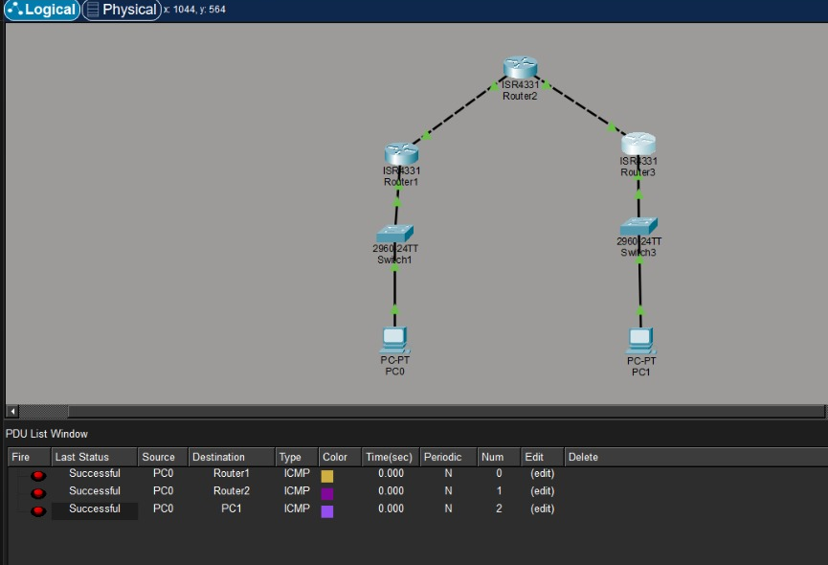
LIVE IMPLEMENTATION
REAL LAB EVIDENCE
Live Lab Evidence — Topology & Connectivity
Captured directly from the Cisco Packet Tracer implementation before the IPsec tunnel is configured.
PACKET TRACER — LOGICAL TOPOLOGY & PDU TEST RESULTS
WHY THIS EVIDENCE MATTERS
Real lab, real topology
PC-A – R1 – R2 (pass-through) – R3 – PC-C matches the addressing table exactly.
OSPF underlay confirmed
ICMP tests to Router1, Router2, and PC1 all return Successful — routing works end to end.
Clean baseline before IPsec
No crypto map is active yet, so this connectivity is plain, unencrypted routing.
Sets up the tunnel evidence
Any encryption seen on the next slides is provably caused by IPsec, not by chance.
IPSEC VPN | SECURE COMMUNICATIONS
16 / 24

Slide 17


LIVE IMPLEMENTATION
Phase 1: IKE / ISAKMP Configuration
ISAKMP Policy 10
Authentication
Key Exchange
Defines control-plane security parameters.
Uses Pre-Shared Keys (PSK) for peer validation.
Establishes a shared, secure management channel.
Encryption: AES-256
Key string: cisco123
Diffie-Hellman Group 5
Hash: SHA
R1 → peer R3 (10.2.2.1)
Encrypted ISAKMP channel
Lifetime: 3600s (1 hour)
R3 → peer R1 (10.1.1.1)
Prepares for Phase 2
IPSEC VPN | SECURE COMMUNICATIONS
17 / 24

Slide 18


LIVE IMPLEMENTATION
Phase 2: IPsec Data Tunnel Configuration
1
2
3
Transform Set
Interesting Traffic
Crypto Map
Specifies payload encryption & integrity algorithms.
ACL defines the traffic that triggers encryption.
Binds peer IP, ACL, and transform set together.
crypto ipsec transform-set 50
esp-aes 256 esp-sha-hmac
access-list 101 permit ip
192.168.1.0/24 192.168.3.0/24
crypto map CMAP 10 ipsec-isakmp
(applied to WAN interface)
IPSEC VPN | SECURE COMMUNICATIONS
18 / 24

Slide 19
LIVE IMPLEMENTATION
Full Running Configuration — R1 (Cisco IOS)
A complete site-to-site tunnel using IKEv1 with AES-256 and SHA, in tunnel mode — matching the lab topology on the previous slides.
R1-BranchA# show running-config
crypto isakmp policy 10
encryption aes 256
authentication pre-share
group 24
crypto isakmp key cisco123 address 10.2.2.1
!
crypto ipsec transform-set 50 esp-aes 256 esp-sha-hmac
!
access-list 101 permit ip 192.168.1.0 0.0.0.255 192.168.3.0 0.0.0.255
!
crypto map CMAP 10 ipsec-isakmp
set peer 10.2.2.1
set transform-set 50
match address 101
!
interface GigabitEthernet0/0/0
crypto map CMAP
IPSEC VPN | SECURE COMMUNICATIONS
19 / 24

Slide 20

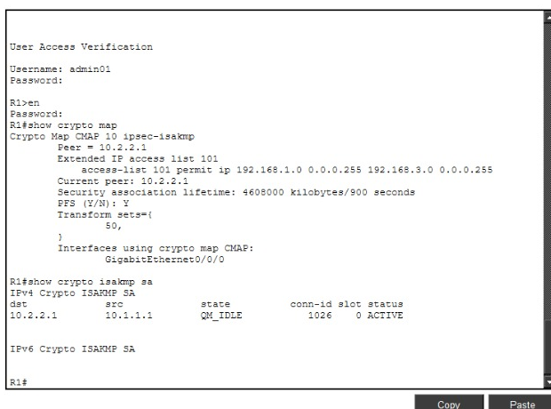
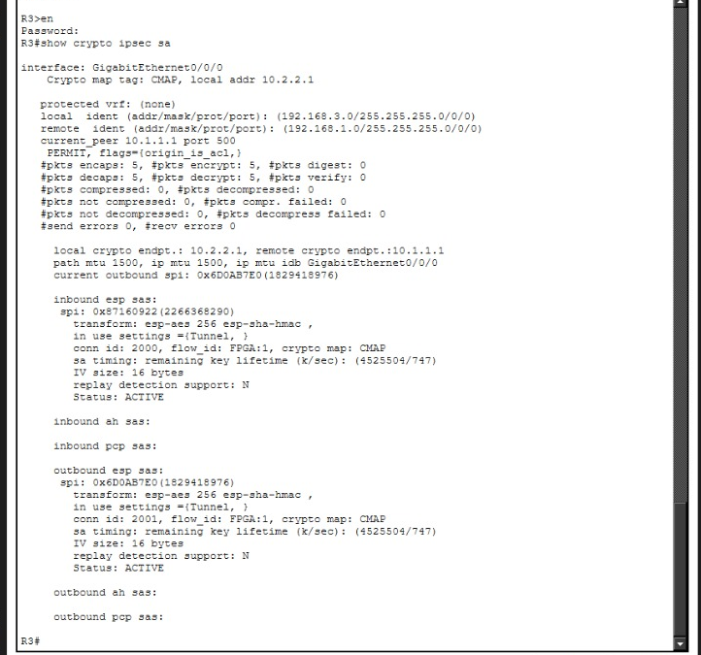
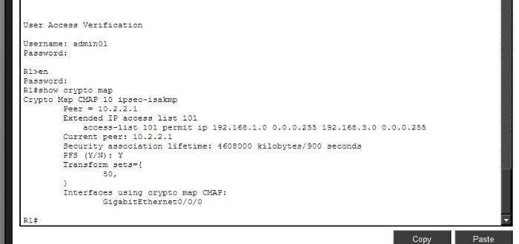
LIVE IMPLEMENTATION
Verification & Active Security Associations
show crypto isakmp sa
show crypto ipsec sa
show crypto map
QM_IDLE
5 / 5 encrypted
Peer 10.2.2.1 · ACL 101
IPSEC VPN | SECURE COMMUNICATIONS
20 / 24

Slide 21



LIVE IMPLEMENTATION
Key Insights From the Lab
Dynamic Tunnel Activation
Uninteresting Traffic Behavior
Local LAN Segment Security
SAs are created on-demand only when “interesting traffic” (LAN-to-LAN packets) matches the defined ACL.
Direct router-to-router pings or OSPF Hello packets pass through standard, unencrypted IP routing.
Traffic between local hosts (e.g. PC-A) and the local router interface remains plaintext; encryption occurs upon exiting the WAN interface.
IPSEC VPN | SECURE COMMUNICATIONS
21 / 24

Slide 22
WRAP-UP
Conclusion
IPsec secures IP traffic at the network layer using AH/ESP for data protection and IKE for automated key management — as demonstrated end-to-end in this session's live Cisco lab.
1
Tunnel mode + ESP is the practical default for real-world site-to-site and remote-access VPNs.
2
IKEv2 (RFC 7296) is the modern, recommended standard — faster, more resilient, and NAT-friendly by design.
3
Strong outcomes depend on current algorithms: AES, SHA-2, and 2048-bit+ / elliptic-curve Diffie-Hellman.
4
The Cisco lab confirmed the theory in practice: ISAKMP + transform sets + crypto maps reliably brought up an encrypted, verifiable tunnel between two branch sites.
IPSEC VPN | SECURE COMMUNICATIONS
22 / 24

Slide 23

SOURCES
References
S. Frankel & S. Krishnan, “IPsec/IKE Roadmap”, RFC 6071, IETF, Feb. 2011.
S. Kent & K. Seo, “Security Architecture for the Internet Protocol”, RFC 4301, IETF, Dec. 2005.
C. Kaufman et al., “Internet Key Exchange Protocol Version 2 (IKEv2)”, RFC 7296, IETF, Oct. 2014.
A. Huttunen et al., “UDP Encapsulation of IPsec ESP Packets”, RFC 3948, IETF, Jan. 2005.
Cisco Systems, “Configuring Security for VPNs with IPsec”, Cisco IOS Security Configuration Guide.
Cisco Systems, “Configuring Internet Key Exchange for IPsec VPNs”, Cisco IOS Security Configuration Guide.
Cisco Networking Academy, “Site-to-Site IPsec VPN Lab Guide”, CCNA Security Lab 19.5.6.
IPSEC VPN | SECURE COMMUNICATIONS
23 / 24

Slide 24
Thank You
Questions & Discussion
TEAM 3
Mohammed Hany Mamdouh • Ahmed Ehab Mohamed • Ahmed Samir Ibrahim
IPSEC VPN | SECURE COMMUNICATIONS
24 / 24

